Slide 1
WHAT IS CHILD SAFEGUARDING?
WHEN YOU HEAR THE WORD “SAFEGUARDING” WHAT DO YOU THINK OF?
Notes:
To start the session, ask the group what things they think would be considered a Child Safeguarding Issue. One of the big things we want to distinguish is between on-field safety (tackle technique, head injury protocols, injury prevention, training loads) and child safety from harm and abuse (physical abuse, sexual abuse, neglect…).

Slide 2
WHAT IS CHILD SAFEGUARDING?
SAFEGUARDING INVOLVES THE PREVENTION AND REPORTING OF ABUSE AND HARM IN SPORT
Sexual Abuse
Physical Abuse
Psychological Harm
Neglect
Swearing Toxic Behaviours Intimidation
Online Communication Behaviour Management
Notes:
When we mention child abuse, we often immediately think of child sexual abuse. That is certainly a very serious issue and one that we want to be sure to prevent. But it is worth remembering that there are other ways that children can be abused. And these other forms of abuse, while often less damaging to a child, can be very common. So while we want to make sure we do everything we can to prevent sexual abuse of children, we should also think about how we can make rugby league an environment where lower-level abuse is also prevented. And in fact, if we can start to reduce the yellow-level issues, the more serious issues will also drop. The reality is that the behaviours we see in the yellow zone are the kinds of things that are happening every week throughout sport.

Slide 3
CHILD SAFEGUARDING – WHAT ARE OUR OBLIGATIONS
NSWRL/NRL
NSW GOVERNMENT
CHILD SAFE PREVENTION
REQUIREMENTS
POLICIES AND REQUIREMENTS
WWCC
10 CHILD SAFE STANDARDS
INCIDENT AND ABUSE REPORTING
CLUB > DISTRICT > NSWRL
POLICE/DCJ/OCG
Notes:
Child Safeguarding can be divided into two parts. Our policies and other requirements exist to help us to prevent harm and abuse from occurring. NSWRL and the NRL have policies to guide clubs. These include rules that all volunteers need to follow.
There are also legal requirements from the NSW Government that help to prevent harm. Clubs need to make sure that their volunteers and staff have a cleared WWCC, and also meet the obligations of the 10 Child Safe Standards.
If an incident does occur, then we may need to report it. Within Rugby League, the key is to report any concerns upwards. Volunteers should report to the committee, club committees to their district and districts to NSWRL. How high up the chain reporting needs to happen is determined by the severity of the incident – there is guidance in the Child Safeguarding Policy. Additionally, while we want you to report concerns in the sport, there may also be situations where you have to report to government agencies. It’s worth noting that there can be situations where you have to report an incident to multiple agencies.

Slide 4
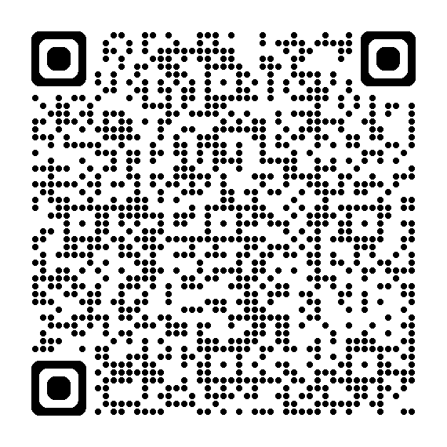
CHILD SAFE PREVENTION: NSWRL/NRL REQUIREMENTS
NRL POLICIES
THESE ARE ALL ACCESSIBLE ON THE NSWRL WEBSITE
NSWRL POLICIES
CLUB/DISTRICT POLICIES
UNIQUE ASPECTS OF YOUR CLUB
Notes:
Let’s start with how we prevent harm and abuse to children in Rugby League. NRL and NSWRL have developed policies and resources to make it easy for clubs. However, we need everyone to use these policies. These policies cover some of the things that we know clubs struggle with. Social Media, giving players rides in cars, changing rooms, travel and overnight stays – more often than not, when you are wondering how you should be operating at your club in terms of safeguarding, the policy will guide you. So you should be familiar with the rules that you and your volunteers are expected to follow, and you should share and enforce those rules at your club. If we can get every club to follow the policy, that will go a long way to minimising issues. You can find these policies using the QR Code on screen.
Along with the state and national policies, your club or district may have some rules of its own. While the NRL and NSWRL rules are very good, they are generic. So you might find there are extra rules that make your club safer. These could be due to the facilities you use, the way you operate, or the needs of your community.

Slide 5
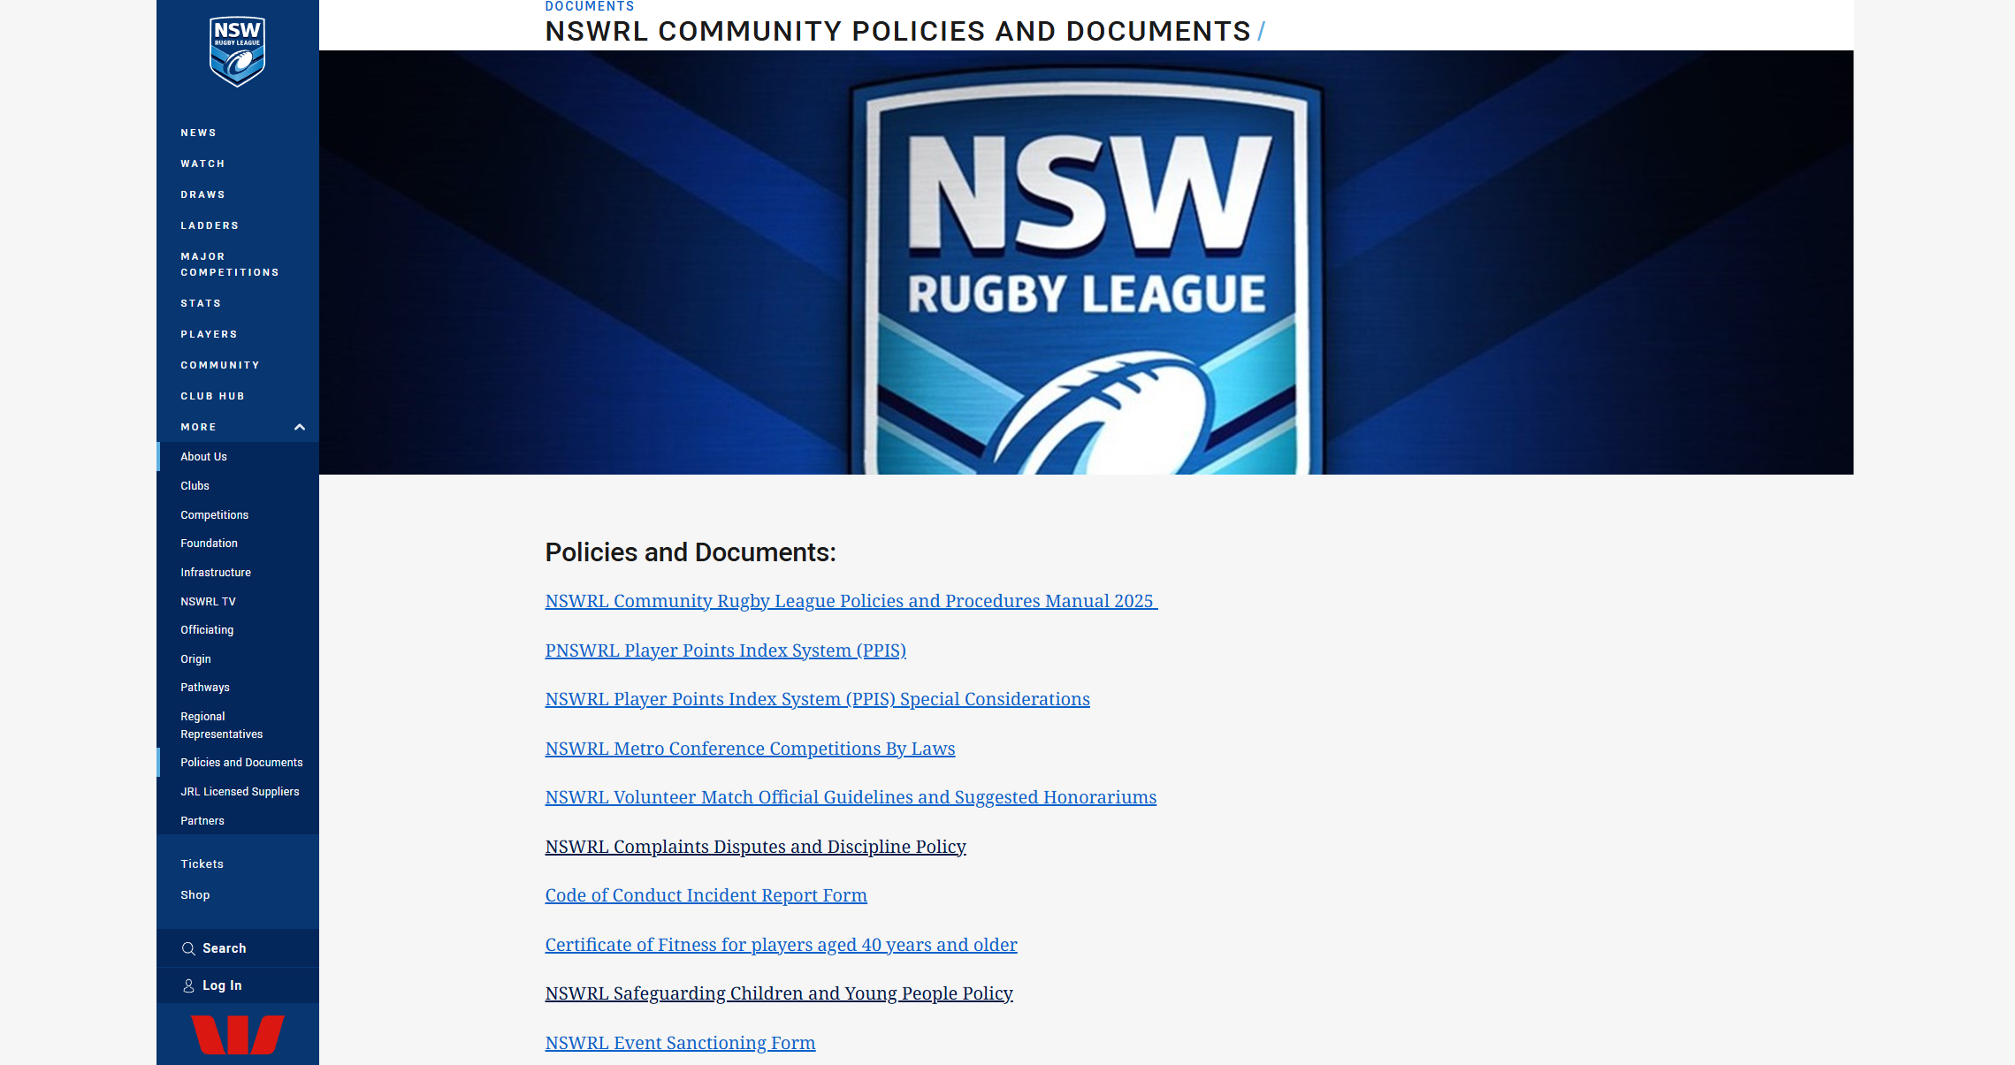
NSWRL/NRL REQUIREMENTS
NRL POLICIES
PATRONS OF THE GAME
NSWRL POLICIES
PATRONS OF THE GAME
CLUB/DISTRICT POLICIES
Notes:
To help you promote the NRL and NSWRL policies, NSWRL has created a page that has all community policies in one place. The tab to access them is circled in red.
Every club should provide a link to this page on their website and/or social media. This link means that all of your volunteers, players, and families can access policies if the need arises. This is more efficient for clubs than trying to create their own page, as they can quickly become out of date. If every club links to the same page, we’ll all be following the same rules throughout the state.

Slide 6
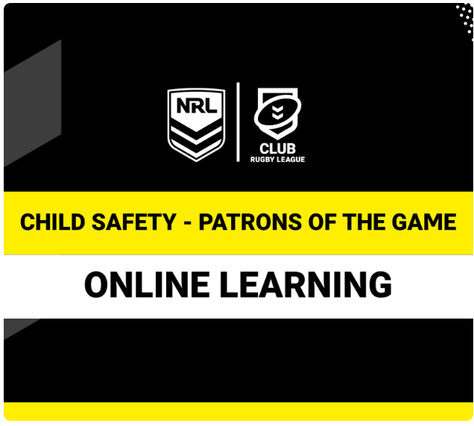

PATRONS oF THE GAME – EDUCATION MODULE
Notes:
Share screen speak to Patrons of the Game education module, compulsory for Coaches, Match officials, Sports Trainers, Volunteers who have attained the age of 18 years and above who work with or in an environment with individuals under 18 years are required to complete Patrons of the Game Child Safe Education. The modules take about 15-20mins and provides some practical tips on practices to improve child safe-guarding.
Patrons of the game is a great resource to quickly and efficiently get every adult in the club to understand safety aspects of working around children.

Slide 7
CHILD SAFE PREVENTION: NSW GOVERNMENT
WWCC
NSW LEGAL REQUIREMENTS
10 CHILD SAFE STANDARDS
Notes:
So along with Rugby League’s efforts to prevent harm and abuse, the NSW government has legal requirements that clubs are expected to adhere to. First there is the Working With Children Check. This helps us to keep people who are known to be dangerous out of our sport.
Additionally, the NSW Government established the 10 Child Safe Standards. These are a set of expectations that we need to live up to.

Slide 8
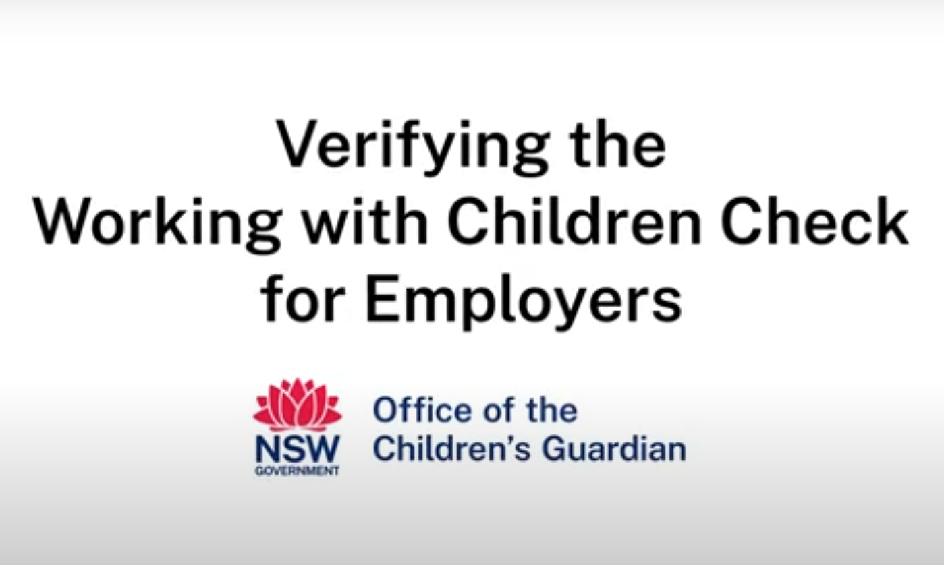
WORKING WITH CHILDREN CHECK and VERIFICATION (NSW)
Notes:
PLAY VIDEO.
A Working with Children Check Coaches, Match officials, Sports Trainers, Volunteers who are 18 years or older who work with or in an environment with individuals under 18 years are required to have a valid and verified working with children check.

Slide 9
WORKING WITH CHILDREN CHECK and VERIFICATION (NSW)
  COACH, VOLUNTEER, MATCH OFFICIAL OR LIKE PERSON REGISTERS WITH MY CLUB
  Step 1 - Coach, match official or volunteer obtains a WWCC via Office of Children’s Guardian and provides a WWCC on registration. Advise potential applicants this is a requirement before formally appointing any volunteers.
  Step 2 – The registering club or association collects the Working With Children Check on registration (entered in My Sideline).
  Please note registration remains pending until verification – registration and involvement in any child related activity is not permitted under ARLC and NSWRL rules where a match official, volunteer, coach, ground manager or other like person doesn’t have a WWCC
  Step 3 – IMPORTANT YOUR CLUB Child Safe Officer verifies the Working With Children Check on Office of Children’s Guardian portal.
  Step 4 – WWCC verification cleared – Registration approved. The club should keep a record of who they have verified. Templates can be found at the Office of the Children’s Guardian’s website [Record Keeping Template]
  WWCC expires after 5 years and must be renewed. The club or association needs to re-verify the new check.
  Where a volunteer volunteers at a club as a coach or other child related role or League and also officiates for the local Referees Association – verification is required by all entities the person volunteers for.
Notes:
The legislation has two requirements: clubs need to verify WWCCs on the Office of the Children’s Guardian’s portal and keep records of these verifications.
If you keep records of who you have verified, this can save you time in the long run. If someone is continuously connected to your club, you don’t need to verify them every season. Verify them, and then they are in the system until their check expires.
For clubs and Districts that operate across two states, there are specific rules for WWCC requirements. In NSW, you can work using another state’s WWCC for less than 30 days. If you will work in NSW for 30 days or more, then you will need to have a NSW Check, even if you already have one in the state you reside in.

Slide 10
WORKING WITH CHILDREN CHECK and VERIFICATION (NSW)
KEY TAKEAWAYS
Ensure your club /association is registered with the Office of Children’s Guardian as an employer. This is state legislation and a pre-requisite for Active Kids providers as well.
Ensure your association is collecting and verifying the WWCC number for all match officials
Ensure your club is keeping a record of who it has verified. The Office of the Children’s Guardian has templates you can use.
Notes:
Emphasise the mandatory requirements in NSW legislation and understanding of these three points.

Slide 11
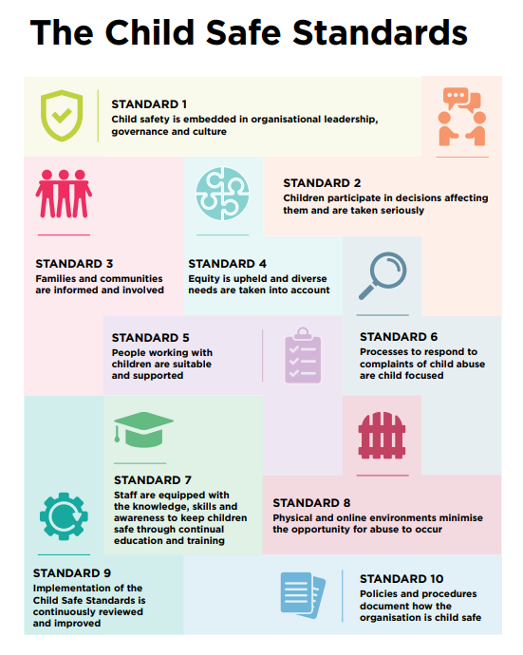
CHILD SAFE STANDARDS – the 10 standards
Notes:
The 10 Child Safe Standards are a legal requirement in NSW for all junior sporting organisations. While legislation varies from state to state, these Standards are based on the Federally developed 10 Child Safe Principles (which came from the Royal Commission into Institutional Responses to Child Sexual Abuse). The Principles guide federal initiatives and are the basis for state efforts, so even if the Child Safe Standards are not mandated in your state, they follow best practice and should align quite closely to those of your state.
This graphic reflects a protective brick wall of the 10 standards for children in our clubs, as we strive to keep children safe.
You take a brick out, the wall weakens.
We want to continue to build our knowledge and awareness of these Standards to improve the environment for children and their families.
Many of the standards are taken care of by following the policies that NSWRL and the NRL have developed for you.

Slide 12
CHILD SAFE STANDARDS – the 10 standards
Notes:
Most of the state requirements can be met by following NSWRL/NRL procedures. However, here are a few areas that you’ll want to handle as a club.
Standard 2 and 3 is all about including children and families in your club, listening to their perspective, and encouraging them to tell you what they think. Does your club create an environment where children and their families feel welcome and safe to speak up? Sometimes the best thing you can do is ask families how they are, and if there is anything they think the club can improve on. Bear in mind that if a child needs to disclose harm or abuse, we may well be asking them to tell a relative stranger about the worst thing that has ever happened to them. That isn’t easy for adults to do, it certainly isn’t easy for kids.
Standard 7 is all about having your volunteers trained to work around children in a safe way. Patrons of the Game is perfect for getting all of your volunteers and paid staff to understand how to be child safe. Additionally, the Office of the Children’s Guardian has developed a sport-specific eLearning that can help your committee with the bigger picture stuff. One such area is Child Safe Risk Management.
Standard 8 is all about Risk Management – it’s one of the most important things you can do for child safety. It gives you the chance to consider your specific environment. Remember how we were saying that the NRL and NSWRL policies don’t quite cover everything. Risk Management is how you plug the gaps at your club both in terms of the physical environment and online communication.

Slide 13
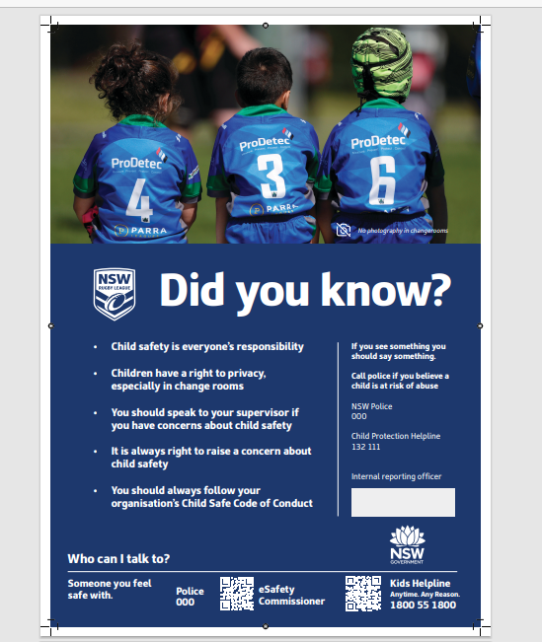
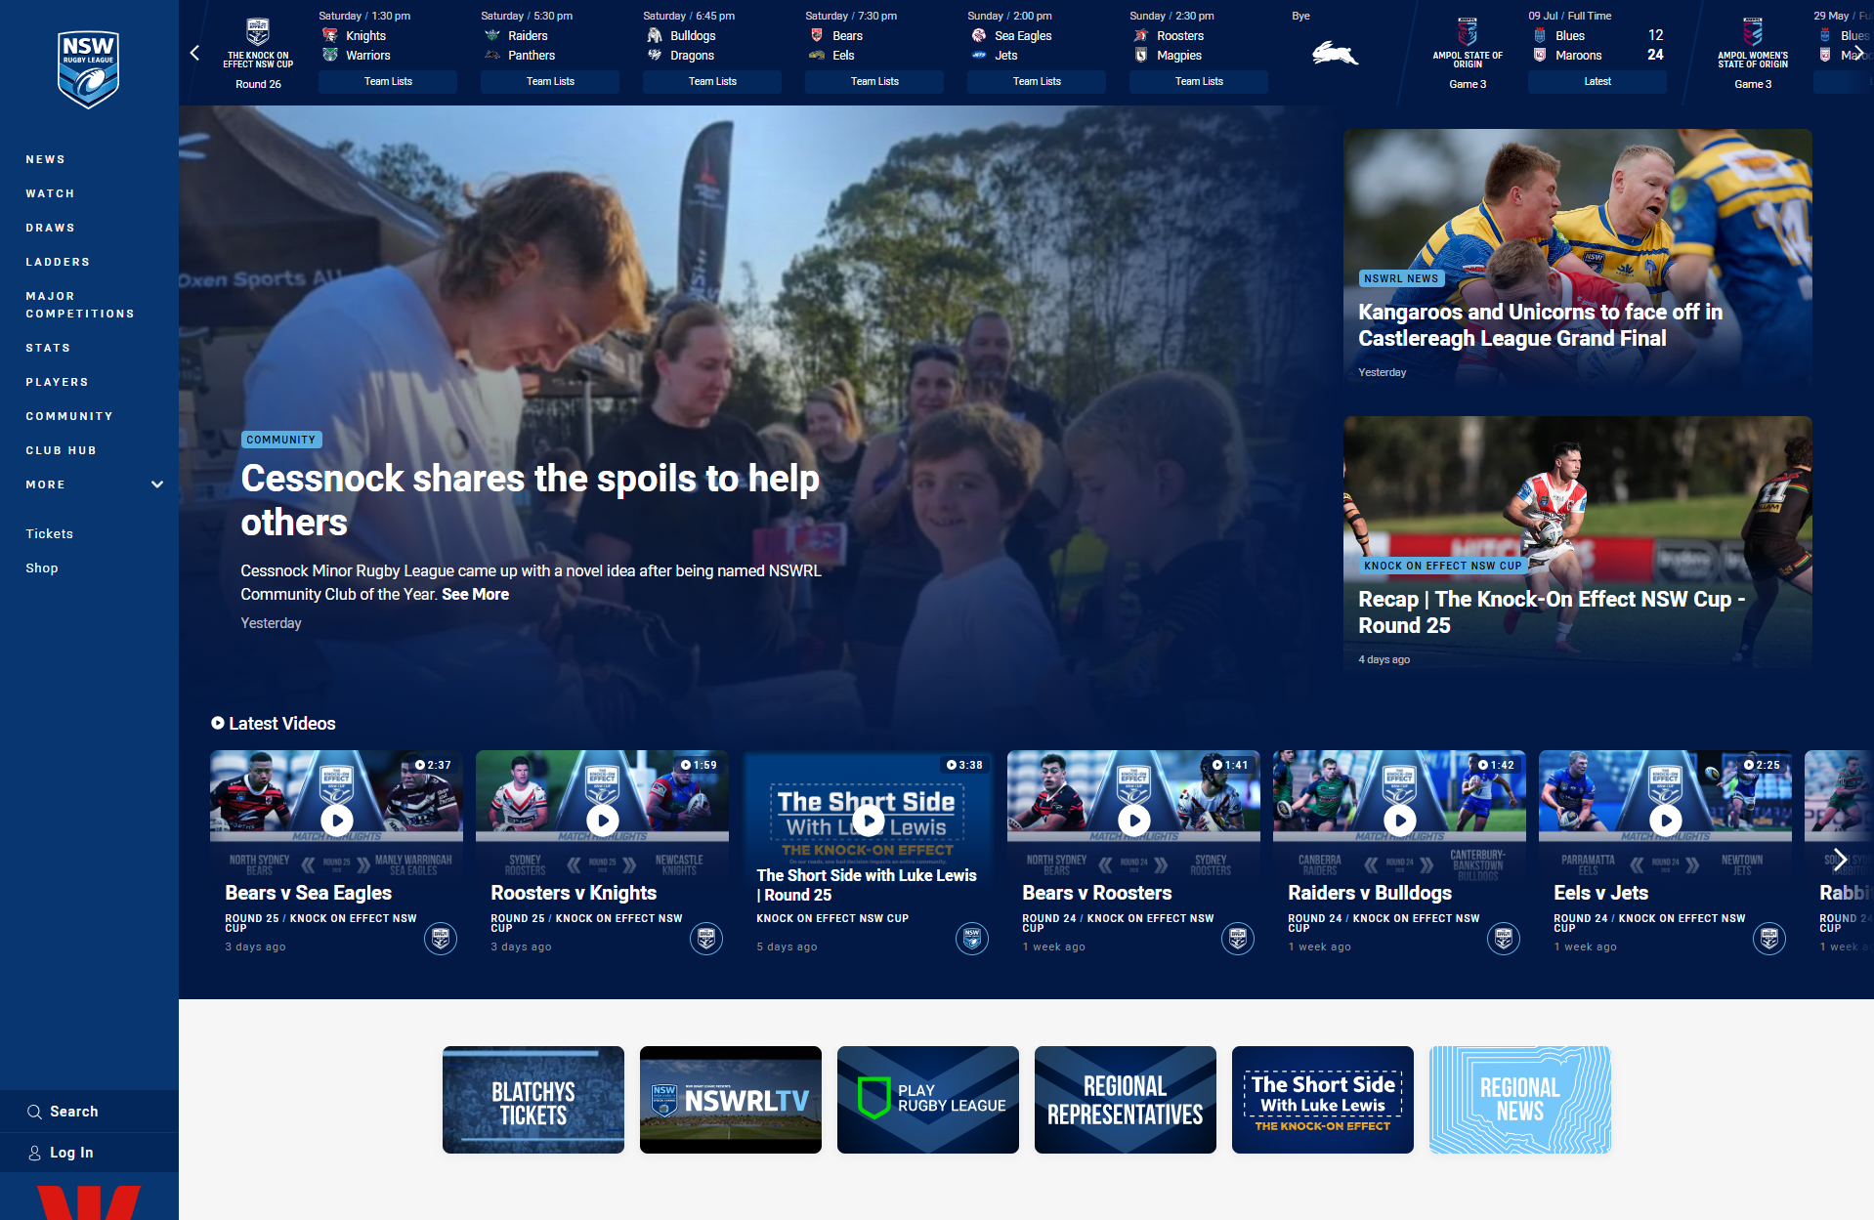
cHILD SAFE STANDARDS – poster example
Notes:
NSWRL has developed resources to help you meet your 10 Standards obligations. If you go to Club Hub, and Select Child Safety, you will policies and resources to help you.
One example are posters that NSWRL developed with the help of the Office of the Children’s Guardian. There are a range of options

Slide 14
CHILD SAFEGUARDING – RISKS
IDENTIFY AN AREA OF RISK WITHIN YOUR CLUB OR ASSOCIATION ENVIRONMENT?
prevention or mitigation strategies?
Notes:
Take 5-10minutes minutes - With the person next to you or at your table identify an area of risk and discuss why and how this is considered an area of risk for Child Safeguarding?
Consider and discuss an existing or potential mitigation strategy your association or club has in place to minimise or prevent that risk?
Encourage feedback and discussion on risks and mitigation strategies.
We welcome feedback and note of any mitigation strategies that help improve our support for clubs in strengthening Child Safety.

Slide 15
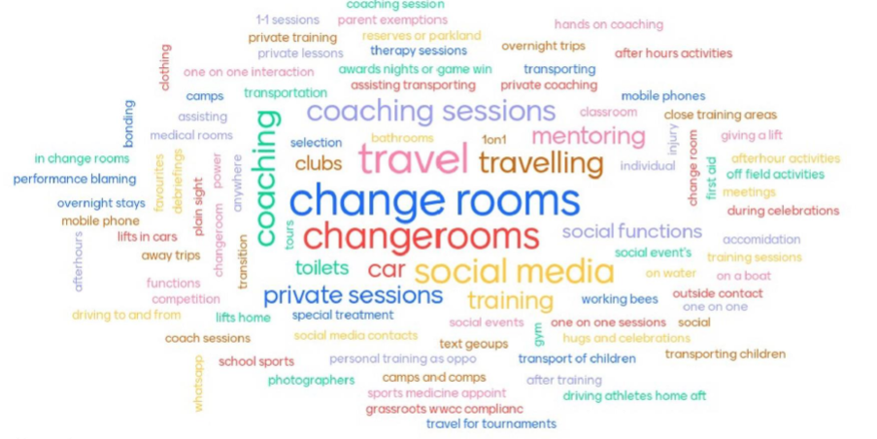
AREAS OF RISK.
Image courtesy Sport Integrity Australia
Notes:
Here is a slide from Sport Integrity Australia that provides a snapshot of responses from a Child safeguarding workshop identifying areas of risk. For more information on risk management, Module 3 of the Child Safe Sport eLearning on the OCG’s website will tell you all you need to know.

Slide 16
REPORTING
The NSWRL Safeguarding Children and Young People policy has guidance for how and who to report to.
Reporting to Government Authorities
If there is immediate danger: contact emergency services on 000.
If a crime may have been committed: contact your local police.
If you are concerned that a child is at Risk Of Significant Harm, you can make a report to the Department of Communities and Justice (DCJ)
If the incident occurred during an overnight stay (team staying in a hotel, travelling to a tournament) you may need to report the incident to the Office of the Children’s Guardian’s Reportable Conduct Unit.
Reporting within Rugby League
You can find a link to the NSWRL reporting portal in the policy
You can email the state MPIO – mpio@nswrl.com.au
You should also keep your District informed of any incidents so they can support you.
Notes:
In terms of reporting an incident, the first thing to think about is where the situation requires you to report to government authorities.
000 is your top priority. Before you worry about making reports, you want to contact emergency services if you need to.
Then we want to consider – police if there is a crime, DCJ if you are concerned about the safety of a child, and the OCG if the incident involves an overnight trip.
You might need to contact multiple agencies over a single matter. If you aren’t sure, make the report – it’s better to be safe than sorry.
Along with these government agencies, you’ll also want the matter to be handled from the perspective of Rugby League. You can report using the NSWRL reporting portal, or email the State MPIO for advice/support. This can be especially important as the person of concern could have other roles in the sport that your club aren’t aware of.
You can also talk to your district. They will support you through the process and offer guidance.

Slide 17
REPORTING
In the case of criminal matters, if there is/will be an active police investigation, you may not be able to inform the family what has happened. Follow the guidance of police before sharing any information to ensure you do not compromise their investigation.
If in doubt, report. Even if your information isn’t enough for the government to take action, passing it on could assist in a future investigation. Your job isn’t to determine what happened, but to pass on information when it is necessary and let others conduct their investigations.
If in doubt, contact your district or the NSWRL MPIO and ask for support.
Notes:
This point is really important. If you make a report to police, ask them before passing the information on to anyone. If the matter is highly sensitive, they may want you to not share anything. For instance, they might be wanting to execute a search warrant, or investigate before the matter gets out. This could even mean not telling the parents about their own child until the police give you the all clear.
And more than anything, just remember that if in doubt, report. Your job isn’t to determine what happened or investigate, but to alert the professionals to step in.

Slide 18
STEPS TO HELP STRENGTHEN CHILD SAFE STANDARDS
Make Child Safeguarding a regular item on the agenda for your club meetings;
Start to consider what child safety risks are at your club, and what you can do to mitigate them;
Elect or appoint a nominated Child Safe Officer(s) or sub-committee reporting to the executive. They will be responsible for child safety initiatives, and WWCC verifications and record keeping.
Add a link to the NSWRL Policy page on your website and put up the Child Safe Posters (supplied by NSWRL) at your playing and training facilities;
Notes:
Here are four key things that clubs can do to improve child safety.
Other things clubs could do (if you are speaking to a group who have already implemented a lot)
A club survey that allows children and families to provide feedback and voice concerns
Club committee completing the OCG Child Safe Sport eLearning

Slide 19

cHILD SAFE STANDARDS CLUB HUB
Child Safe Standards | Club Hub (nswrl.com.au)
Notes:
Scan this code to view the Club Hub with resources relating to Child Safe Standards open up the link and walk through some of the resources.
Share the voice recording by Tim Gilbert that talks through our commitment statement.
We welcome any feedback to improve resources available to assist clubs.

